Slide 1


Chapter 3
Making apps more interactive through data input

Slide 2
Learning Objectives
1. Introduction to JavaScript
2. Introduction to jQuery for mobile devices
3. How to embed JavaScript in a web page
4. How to use an external JavaScript file on a web page
5. How to use CSS elements designed for mobile devices
6. How to accept input through a web page
7. How to use different types of input widgets
8. How to link multiple mobile pages in an app

Slide 3
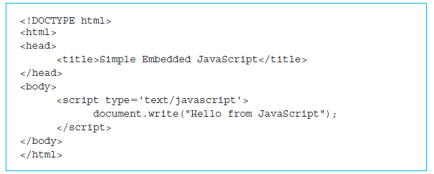
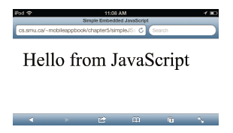
Embedding JavaScript in an HTML5 document
JavaScript is commonly used for mobile app programming.
Method of interpretation

Slide 4
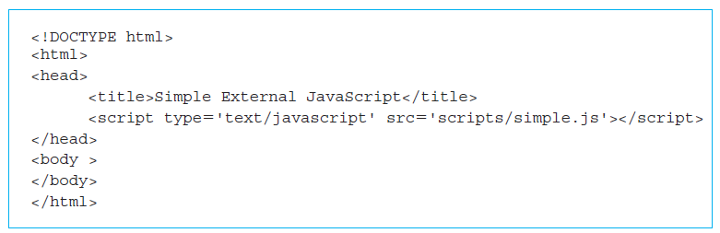
Using JavaScript from an external file in an HTML5 document
The <body> of the web page is empty.
In the <head> we have a <script>...</script> pair of tags to indicate the script that should be run.

Slide 5
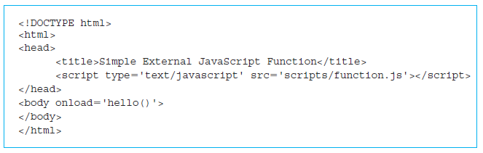
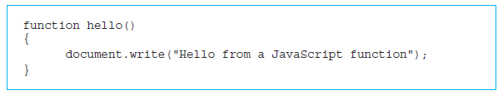
A JavaScript function
functionJS.html
Script file function.js

Slide 6
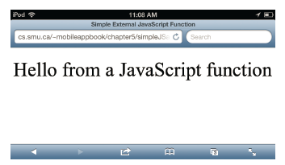
Screenshot of the JavaScript function run at the time of loading

Slide 7
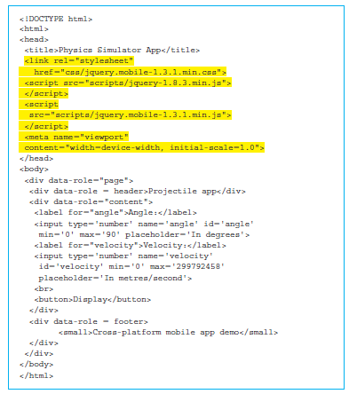
Input widget in HTML5/jQuery/jQuery Mobile
HTML5 code that is specifically designed to ensure that it can work on all the popular mobile devices as well as the conventional desktop/laptop web browsers is shown below.
http://jquery.com/: “jQuery is a fast, small, and feature-rich JavaScript library.”

Slide 8
Input widget in HTML5/jQuery/jQuery Mobile (cont’d)
http://jquerymobile.com/:
“A unified, HTML5-based user interface system for all popular mobile device platforms, built on the rock-solid jQuery and jQuery UI foundation.”
“Its lightweight code is built with progressive enhancement, and has a flexible, easily themeable design.”
“‘write less, do more’ mantra”
Can “design a single highly-branded web site or application that will work on all popular smartphone, tablet, and desktop platforms.”

Slide 9
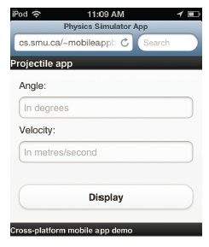
Screenshot of the web page with input for the Projectile app

Slide 10
Designing our apps
Must consider the end user and the main objectives of the app.
How to organize functionalities.
The core functionality should be the first screen that users see when they access your app.
Other functionalities should be placed in a menu of some sort to provide easy access.
Communication between the app and the user.
Must consider what device or devices users will use to access your app.

Slide 11
Our first app: physics Projectile app
Physics behind launching a projectile.
Calculate the distance of a projectile based on the angle and velocity input by the user.
The calculation page will open first when you start the app.
A menu bar will provide navigation between the two main sections.
Menu bar should be consistent across all sections of the app
Easy to read colors and fonts

Slide 12
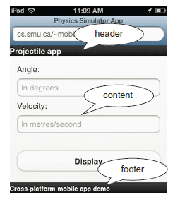
Header, footer, and content data-role
The body of the web page is wrapped in a pair of <div>...</div> tags with an attribute called data-role whose value is set to "page".
Add three pairs of <div>...</div> tags with data-role set to "content", "header", and "footer".

Slide 13


More widgets in HTML5/jQuery/jQuery Mobile
Use a pair of tags <button>...</button> with the text “Display” inside the tags.
type
name
id
min
max
placeholder

Slide 14
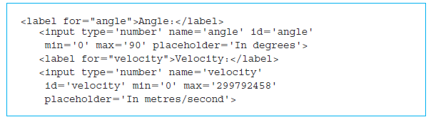
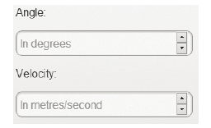
HTML5 code for the angle and velocity input

Slide 15
Identifying elements from a web page
1. The header section includes another script using the code which includes the file
physicsProjectileApp1.js from the folder scripts
<script type='text/javascript'
src='scripts/physicsProjectileApp1.js'>
</script>
2. The code for the button widget now has an attribute called onclick that calls a JavaScript function display defined in physicsProjectileApp1.js
<button onclick="display();">
3. We also see a pair of <table>...</table> tags with two rows and three columns that correspond to the two lines below the Display button.
4. A feature we see throughout the HTML5 code is the "id" attribute.

Slide 16
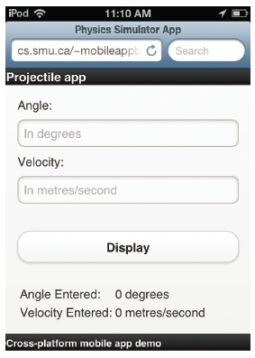
Screenshot of the Projectile app before the values are input

Slide 17
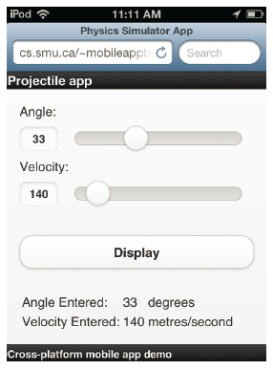
Range slider input widget
In a mobile device with touch-screen facility, we should provide facilities to interact without a keyboard whenever possible.

Slide 18
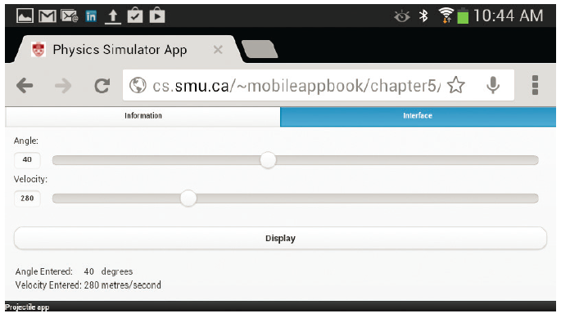
Range slider input widget (cont’d)
The choice of file name: index.html.
Pair of tags <a>...</a>.
Class set to the values ui-btn-active and ui-state-persist.

Slide 19
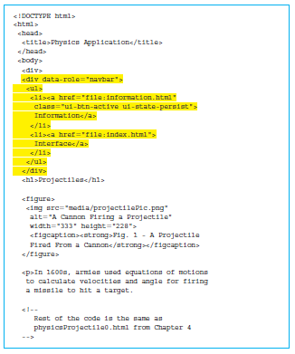
HTML5 code for the navbar in the information tab

Slide 20
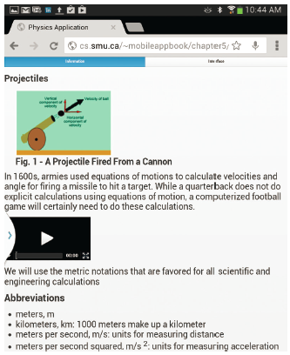
Screenshot of the navbar and the information tab

Slide 21
Quick facts/buzzwords
JavaScript: A programming language popularly used for web programming.
Client-side programming: Programs that run on the user (client) device.
Server-side programming: Programs that run on the web server.
High-level languages: Languages that use English-like words for computer programming.
Compiled programs: Programs that are translated once and translated copy is run many times.
Interpreted programs: Programs that are translated one instruction at a time every time they are run.
Function: A program snippet that performs a particular task.

Slide 22
Quick facts/buzzwords (cont’d)
Widget: Refers to various elements in the web page such as buttons, text boxes, or sliders.
<input> </input>: A pair of HTML5 tags to include widgets that facilitate input from the user.
<button> </button>: A pair of HTML5 tags to produce a button in a web page.
<label> </label>: A pair of HTML5 tags to produce a label in a web page, usually associated with a widget.
id: An attribute used in conjunction with a number of HTML5 elements to uniquely identify the element.

